Slide 1
TEXT SUMMARY GENERATOR (For amazon fine food reviews) NAME : Mithunika.K.R ROLL NO: 1932026

Slide 2
SCOPE OF THE PROJECT:
In the field of marketing, customer reviews can often be too long and descriptive. Analyzing these reviews manually is really time consuming. To overcome this, Natural language processing can be used to summarize these long texts.
The objective is to generate the summary for the amazon fine food reviews using the abstraction based method of text summarization.
Description of the reviews are the input data and the title of the review is the target data. The dataset is taken from Kaggle.
The code is written in python and tensorflow(deep learning library).To get the summaries,a bi-directional RNN is used as the encoding layer and attention as the decoding layer.

Slide 3
OBJECTIVE:
The objective is to generate the summary for the amazon fine food reviews using the abstraction based method of text summarization.

Slide 4
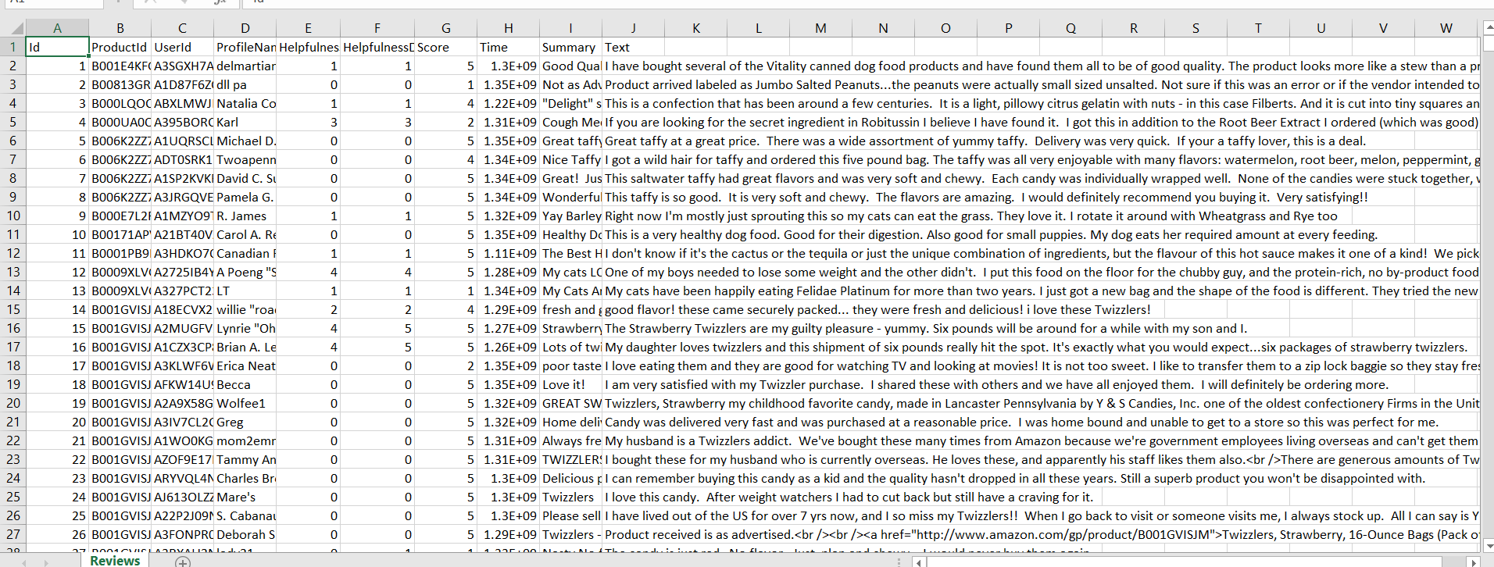
DATASET :

Slide 5
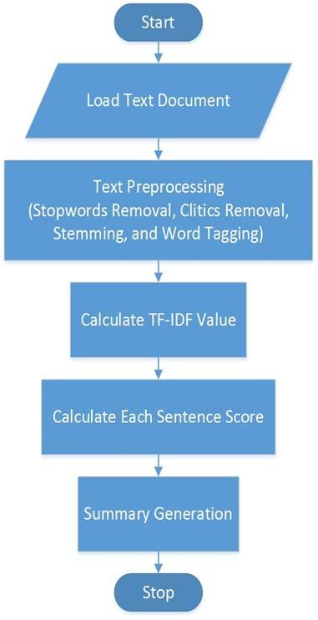
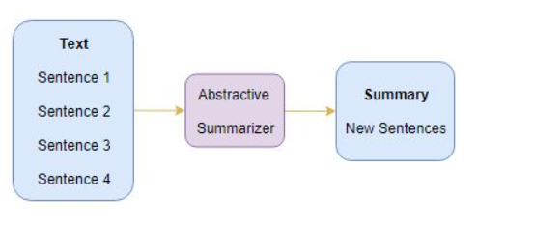
WORKFLOW:
Preparing tokenizer
Model building

Slide 6
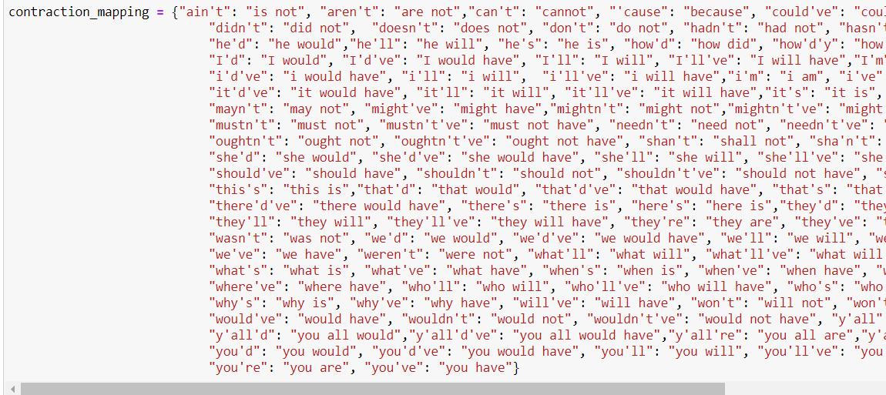
IMPLEMENTATION
Preprocessing:
Contraction mapping

Slide 7
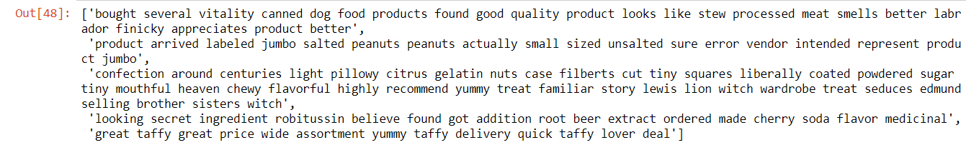
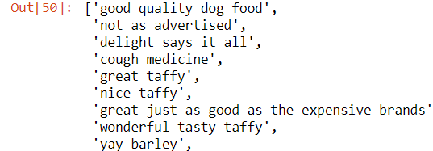
Text cleaning: b) Summary cleaning:
Convert everything to lowercase
Remove HTML tags
Contraction mapping
Remove (‘s)
Remove any text inside the parenthesis ( )
Eliminate punctuations and special characters
Remove stopwords
Remove short words

Slide 8
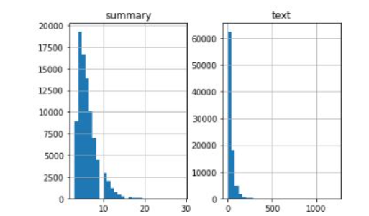

To analyze length of review and summary[to get idea about distribution of length of text]
max length of review = 80
max summary length = 10
Splitting training(90%) and testing(10%)data.
Tokenizer:
Text tokenizer
Summary tokenizer

Slide 9
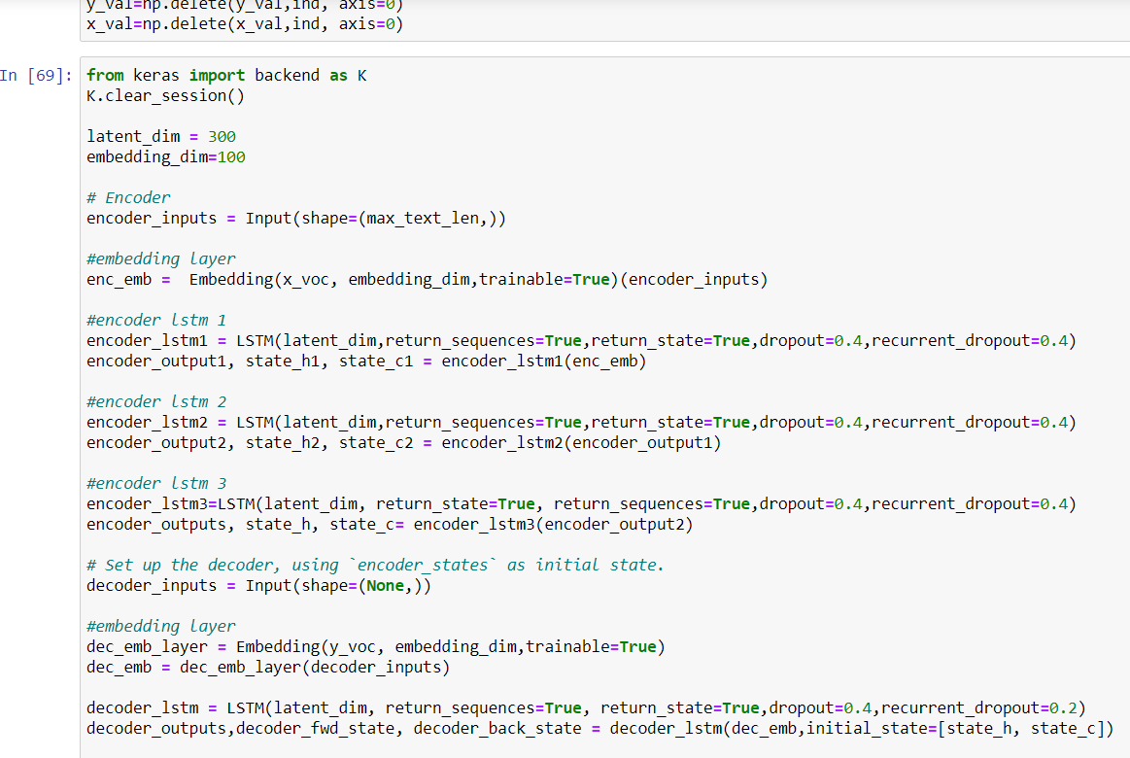
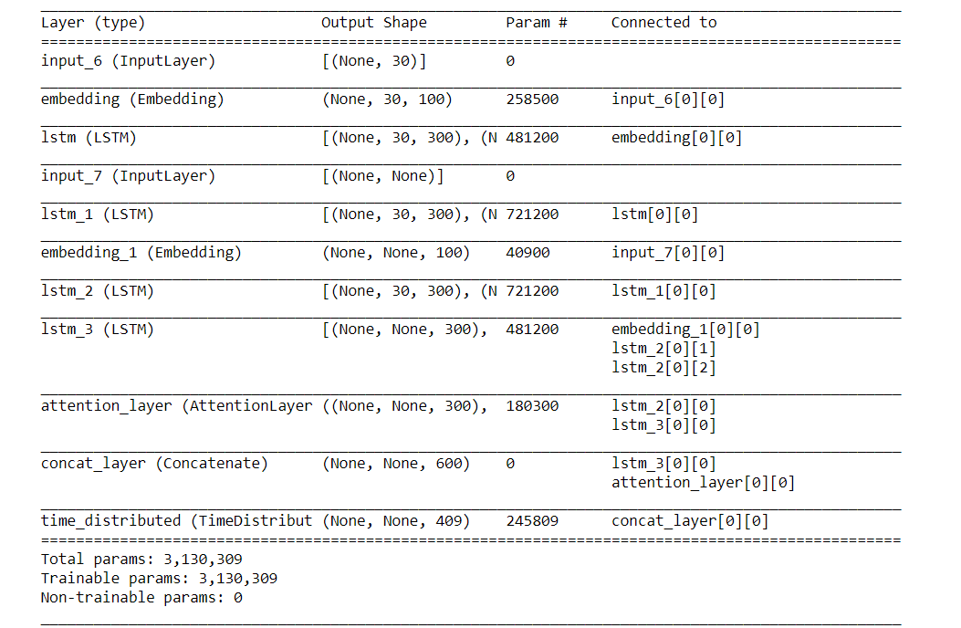
MODEL BUILDING:

Slide 10
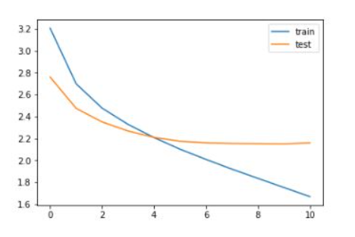
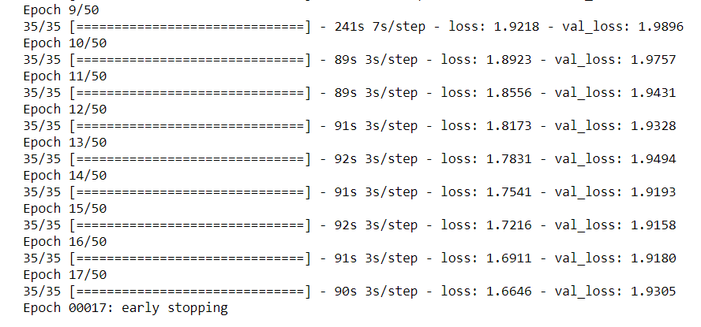
Diagnostic plot(to understand the behaviour of the model over time)
We can infer that there is a slight increase in the validation loss after epoch 10. So, we will stop training the model after this epoch.

Slide 11
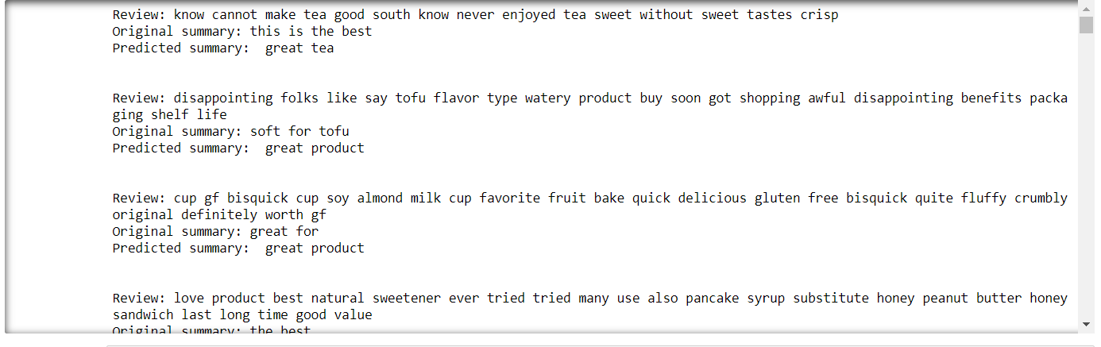
OUTPUT:

Slide 12
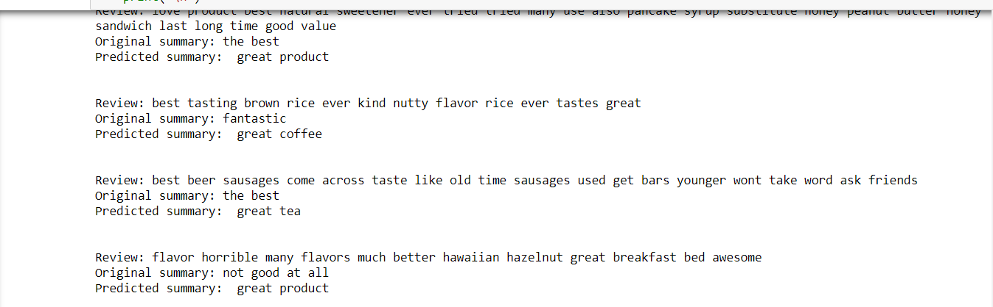

Slide 13
